Slide 1
Anomalously strong near-neighbor attraction in doped 1D cuprate chains
Group meeting Sep. 15th
Chen et al., Science 373, 1235–1239 (2021) 10 September 2021

Slide 2
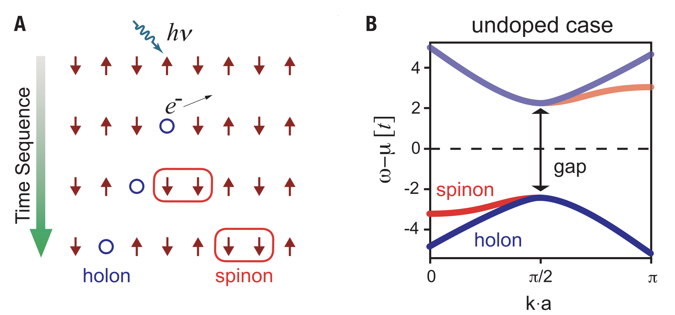
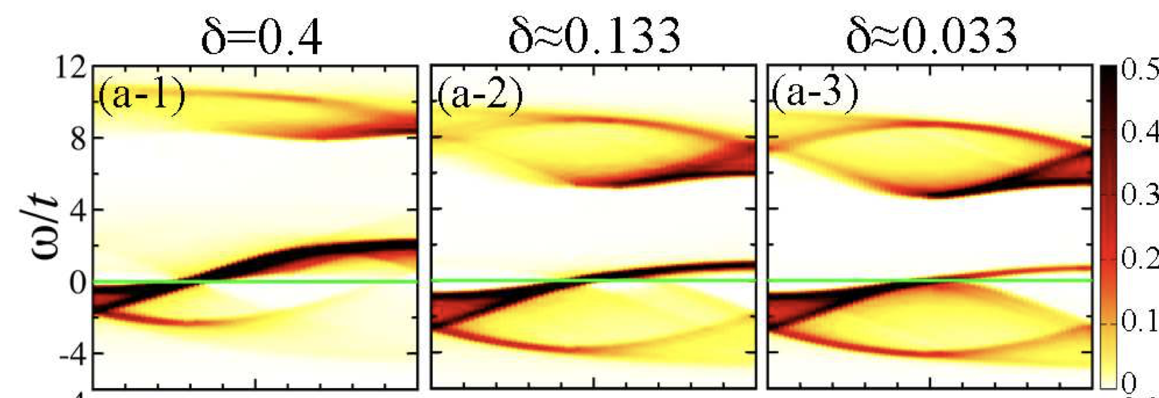
Spin-charge separation in a 1D system
Schematic of an example photoemission process in a 1D AFM chain
Schematic diagram of the spectral dispersion relation for an undoped chain.
Spectrum functions from Bethe ansatz for Hubbard model.
DOI: 10.1103/PhysRevLett.105.106402

Slide 3
The motivation of the experiment
So far, there remains no exact solution of many-body Hamiltonians in 2D cuprate systems, making a quantitative comparison between theory and experiment a challenge.
In particular, it remains undetermined whether fundamental Hamiltonians, like the Hubbard or t-J models, contain all of the essential ingredients for general cuprate properties, including d-wave superconductivity in 2D.
To address this question, a doping-dependent study of a 1D cuprate chain compound would be beneficial.

Slide 4
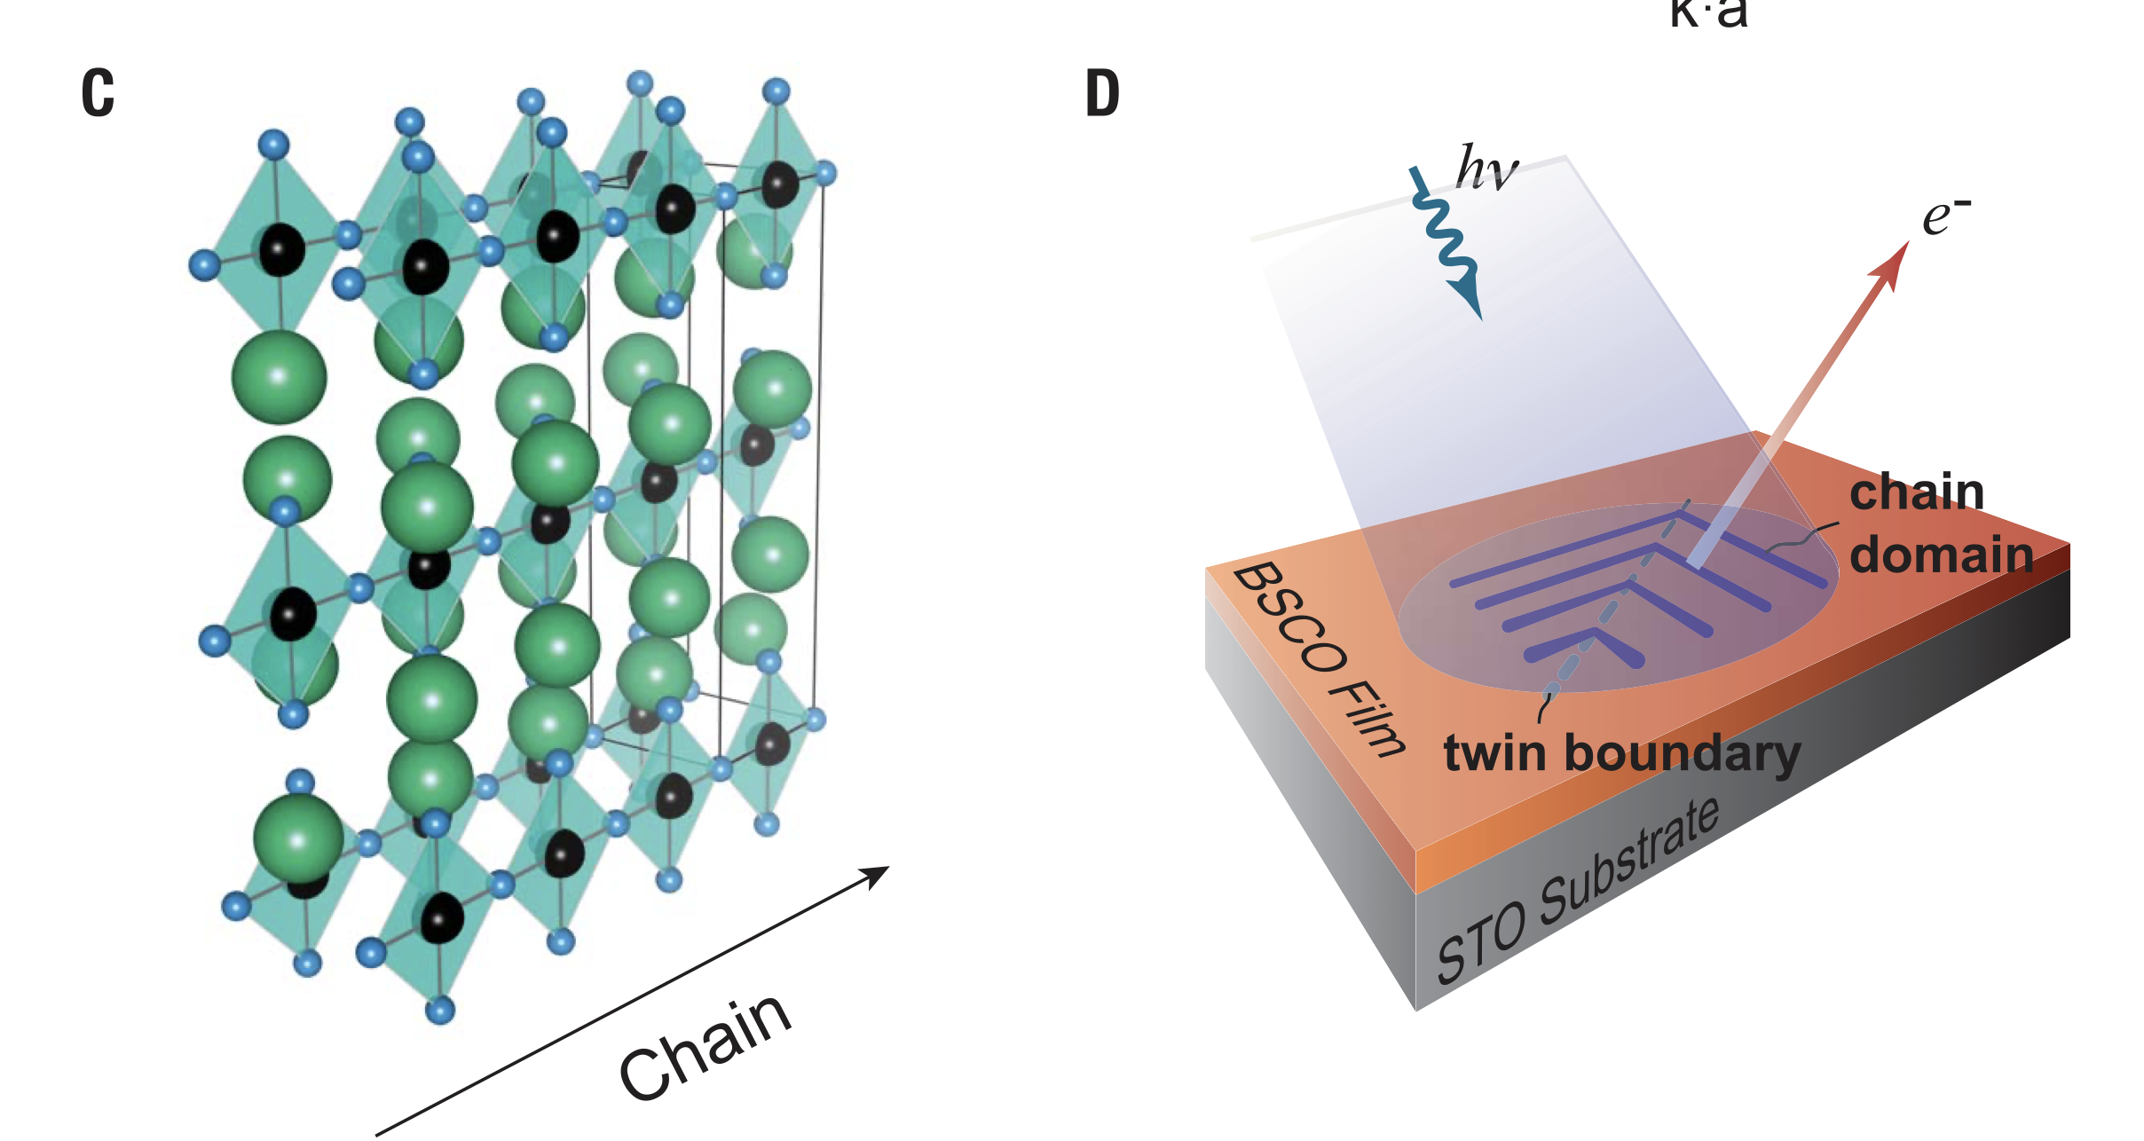
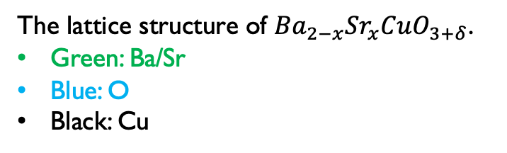
The 1D cuprate and experiment set up
All ARPES data shown below were collected for temperatures lower than 20 K with 65-eV photons, from one single 2.5 unit-cell sample with nominal x = 0.16.
Doping was controlled by interstitial oxygen.
The lattice structure of ${Ba}_{2−x}Sr_{x}CuO_{3+δ}$.
Green: Ba/Sr
Blue: O
Black: Cu
Schematic of sample setup for photoemission.

Slide 5
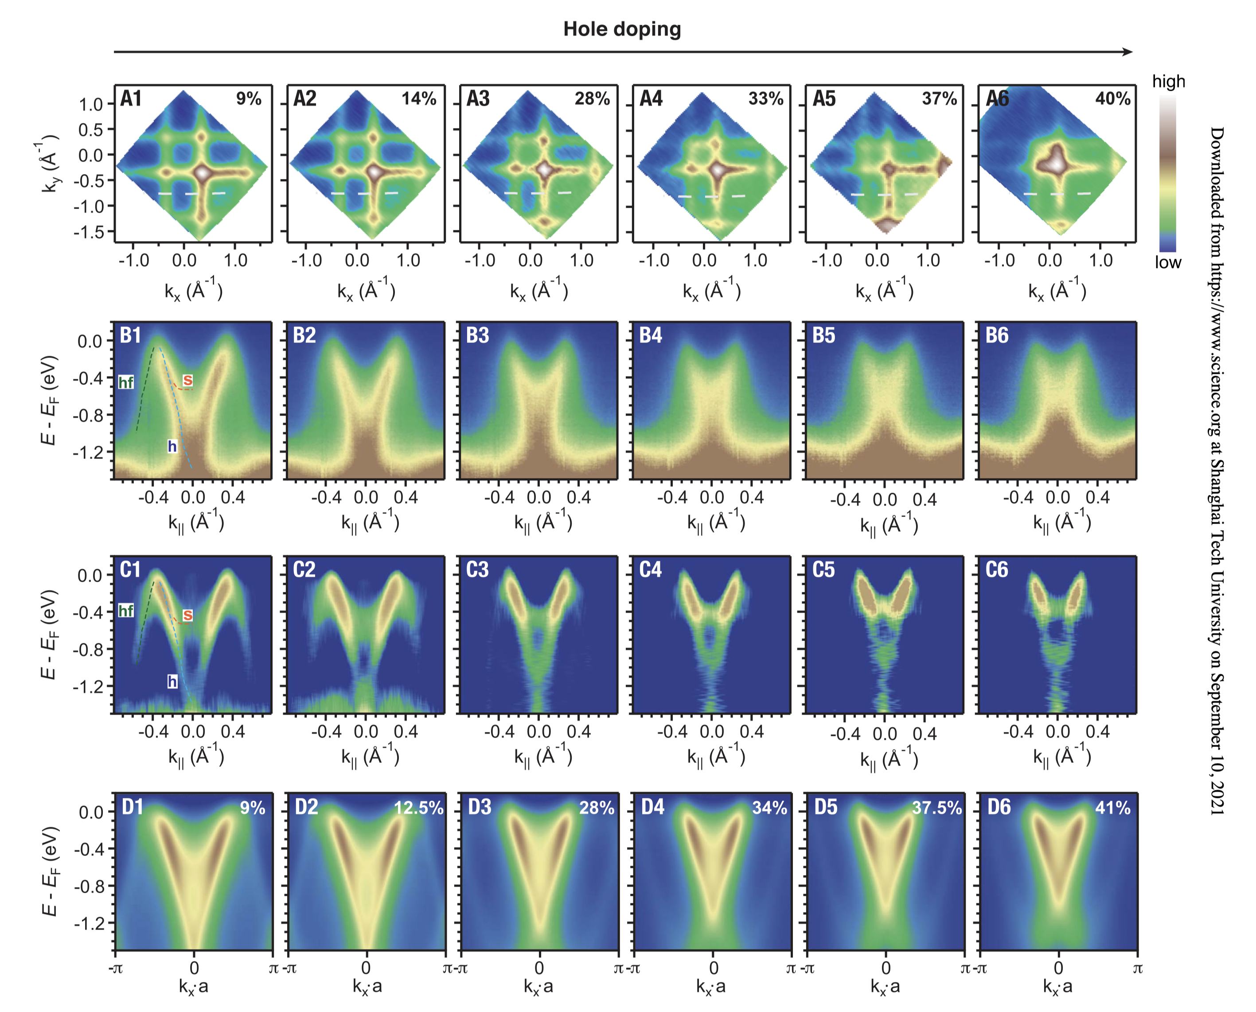
ARPES results
(A). Fermi surface maps with different doping levels.
(B). ARPES spectra taken along the cuts shown with white dashed lines in (A)
(C). Second derivatives of energy distribution curves and momentum distribution curves are summed with sign reversed for comparison.
(To highlight the quasiparticle features.)
(D). Spectral function simulation results based on 16-site cluster perturbation theory (CPT).

Slide 6
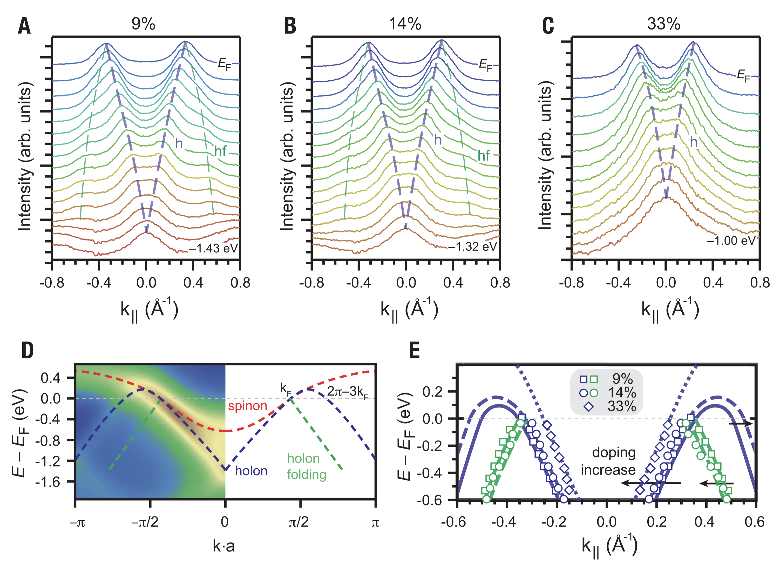
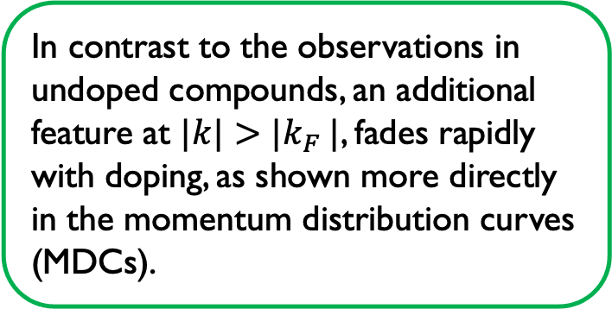
Holon folding
In contrast to the observations in undoped compounds, an additional feature at $|k|>|k_{F} |$, fades rapidly with doping, as shown more directly in the momentum distribution curves (MDCs).
(A to C) MDCs
(D) CPT simulation based on single-band Hubbard model for the 12.5% doping case.
Note that the holon folding feature (faint white) is relatively weak and barely visible in the color-scale plot for the CPT simulation of pure Hubbard model.
(E) Peak positions extracted from MDCs for different dopings overlaid on theoretical lines.

Slide 7
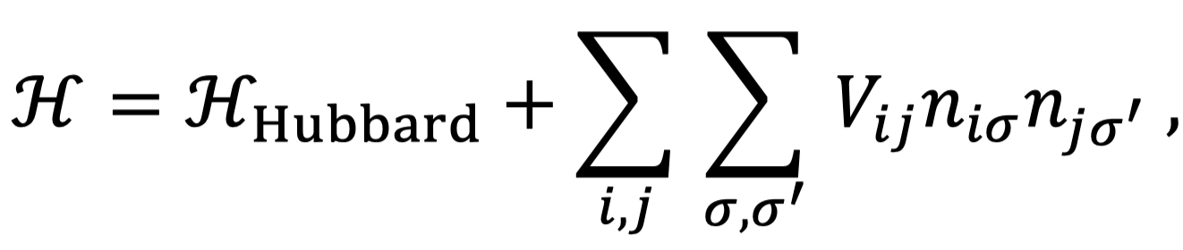
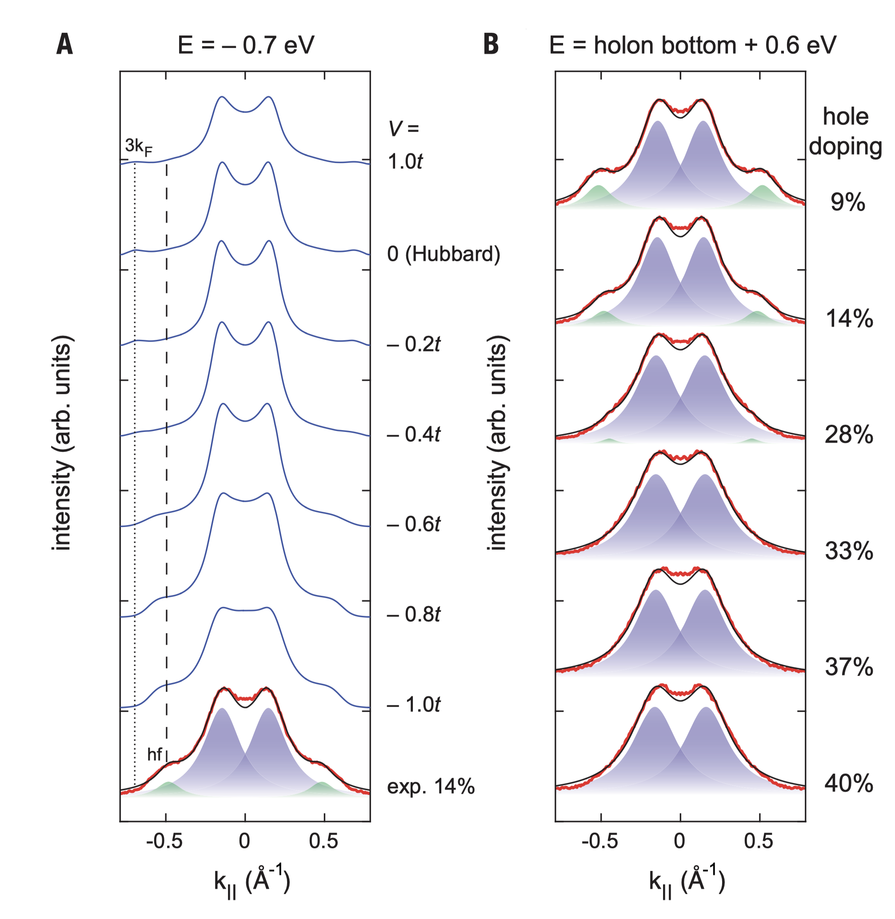
The near-neighbor attractive interaction
The presence of the hf branch agrees with predictions using the single-band or t-J models, previously attributed to a holon-holon interaction mediated by the spin superexchange and intrinsic in these models. This interaction occurs in the lowest-order t/U expansion as an attractive form with the magnitude ~J/4 ~ 0.1t.
But the simple Hubbard model is fundamentally deficient in accurately addressing additional spectral features.
the Hubbard model prediction (second curve from top) shows that the relative intensity of the hf feature is rather weak compared to the 3kF branch, whereas the experimental observation is the opposite.
(A-B). Blue line: CPT simulation; Red line: experimental MDC

Slide 8
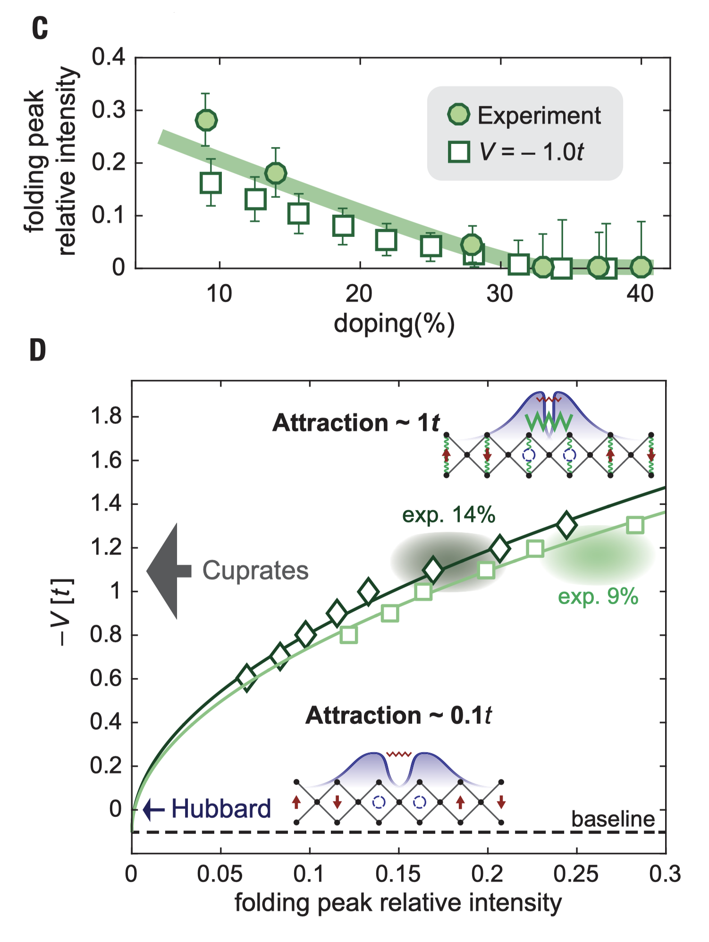
The near-neighbor attractive interaction
(C). Square is simulation.
The doping dependence of the hf peak intensity is captured for a fixed V.
The Coulomb interaction between electrons should always be repulsive, so the only probable origin of this effective attraction, beyond spin superexchange already accounted for in the Hubbard model, would be coupling to some bosonic excitations. Although multiple bosonic modes may play a role in cuprates, here, we postulate that the attractive V is mediated by phonons, considering the evidence of electronphonon coupling in a variety of cuprates.
(D). CPT simulation’s -V v.s. folding peak. (squares: 9%; diamonds: 12.5%). Solid lines are quadratic fitting.
Inset: Schematic of holon attractions for the pure Hubbard model (lower) and the mediation by bosons (upper).
Green springs: electron-phonon coupling
blue shades: holon distributions
red zigzags: AFM-mediated attractions
green zigzags: boson-mediated attractions.

Slide 9
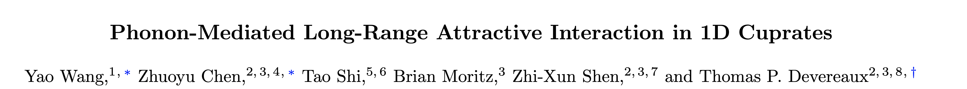
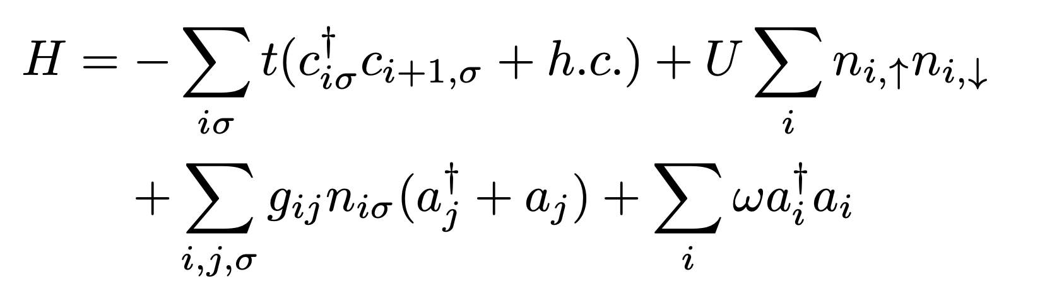
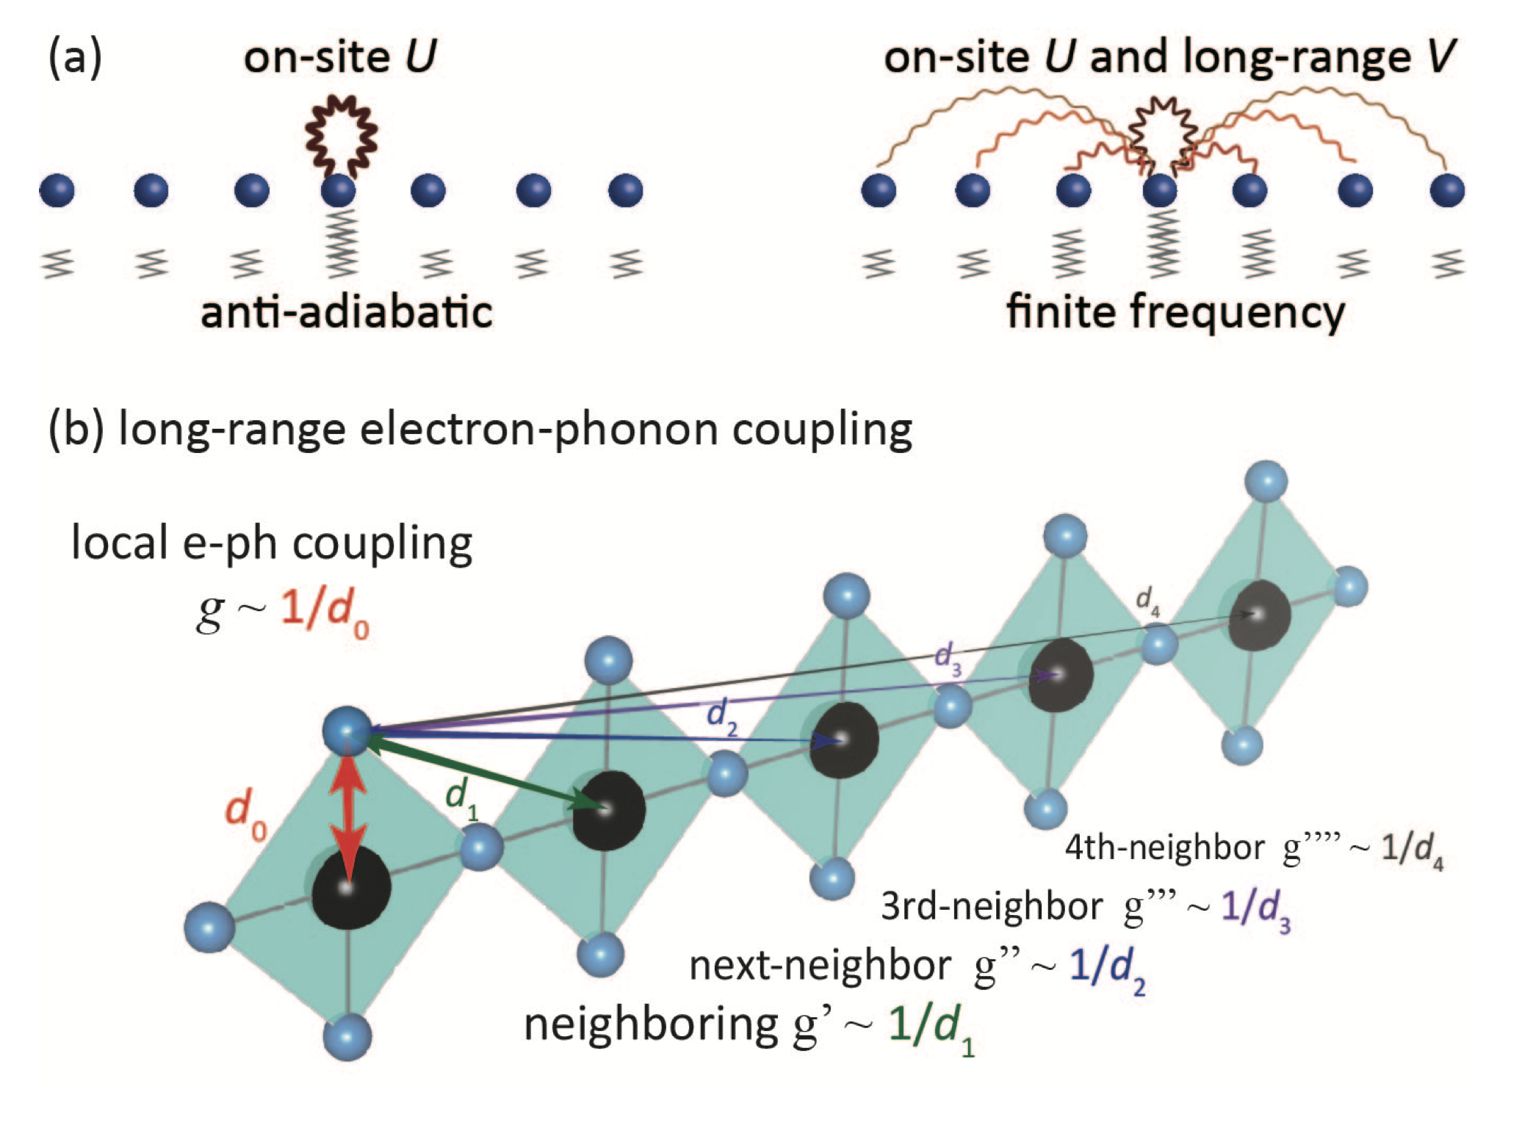
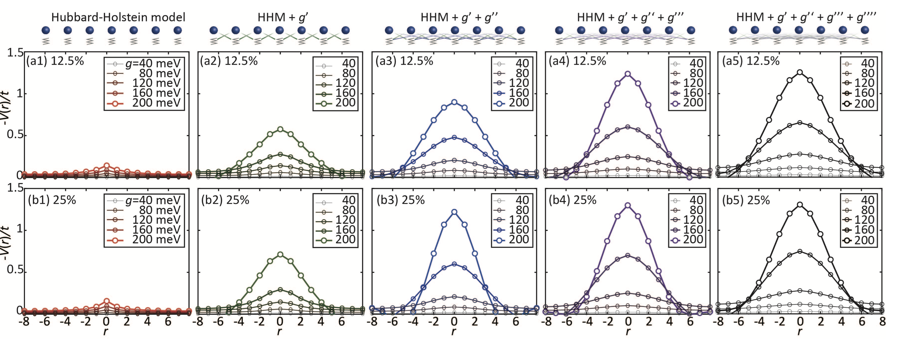
Arxiv: 2107.05773v1
Holstein-Hubbard model

Slide 10
Thanks

Slide 11
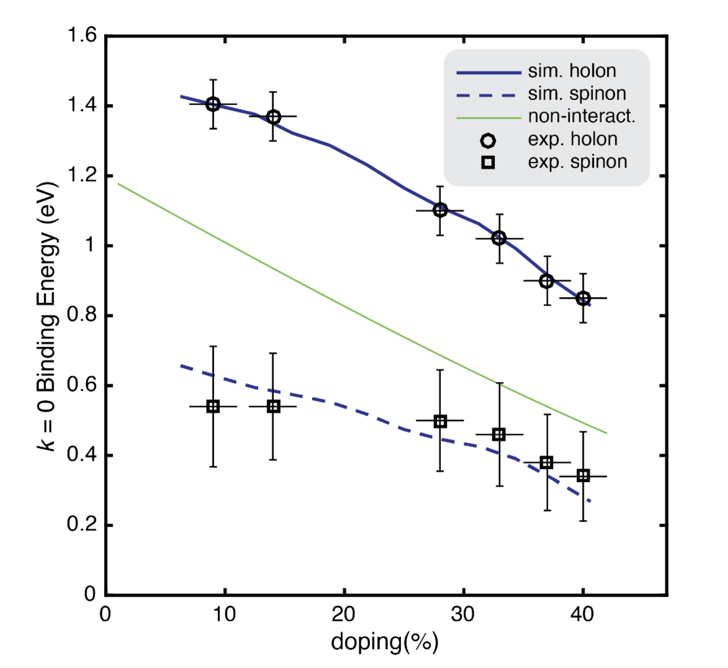
Binding energy of the holon and spinon, gives Hubbard U=8t, (t=0.6eV, J=4t^2/U=0.3eV)

Slide 12
An order-of-magnitude estimate of the effective interaction can be given by assuming V ~ g^2 /w, where g is the electronphonon coupling strength and w is the phonon frequency. Taking the phonon energy w as 50 meV, and the extracted effective interaction V = –t (Fig.4 in the main text) leads to an estimate for the coupling of g ~ 175 meV, which is consistent with the estimate from resonant inelastic x-ray scattering measurements on another 1D cuprate system

